Slide 1
Quantitative Biological Research with Python (92847)
TA 2 – More Python

Slide 2
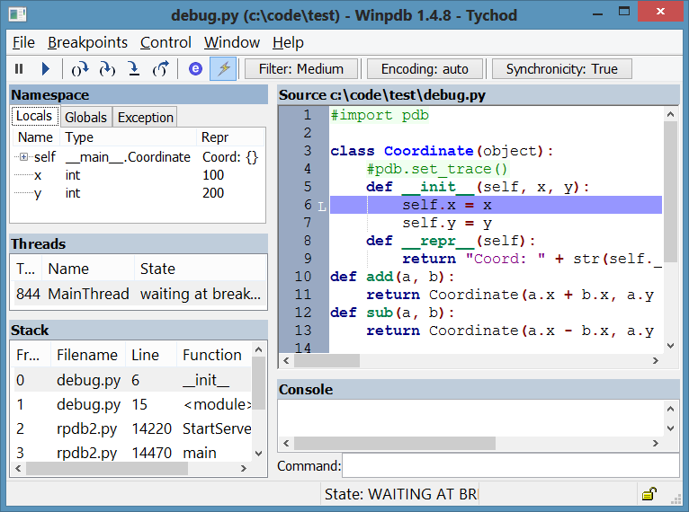
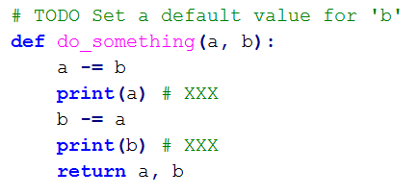
Debugging
You can just use prints
  (don’t forget deleting them later)
Comment conventions:
    XXX = delete me
    TODO = (something) to do
If you use an IDE, there are debuggers…

Slide 3
Learning how to learn
It’s impossible to learn how to do everything in Python
A key part of programming is searching for answers
  How to do something
  How to do something properly
  Why something doesn’t work as expected
“Give a man a fish and you feed him for a day; teach a man to fish and you feed him for a lifetime.“
Albert Einstein

Slide 4
Getting answers
Google is your best friend
Stackoverflow is your second best friend
Python docs (https://docs.python.org)
Don’t be afraid to read the manual
Don’t even be afraid to read source code
README.txt files
More options:
  Tutorials
  Forums
  GitHub Issues
Don’t be afraid to try (e.g. Python shell)
Asking for help is also legitimate

Slide 5
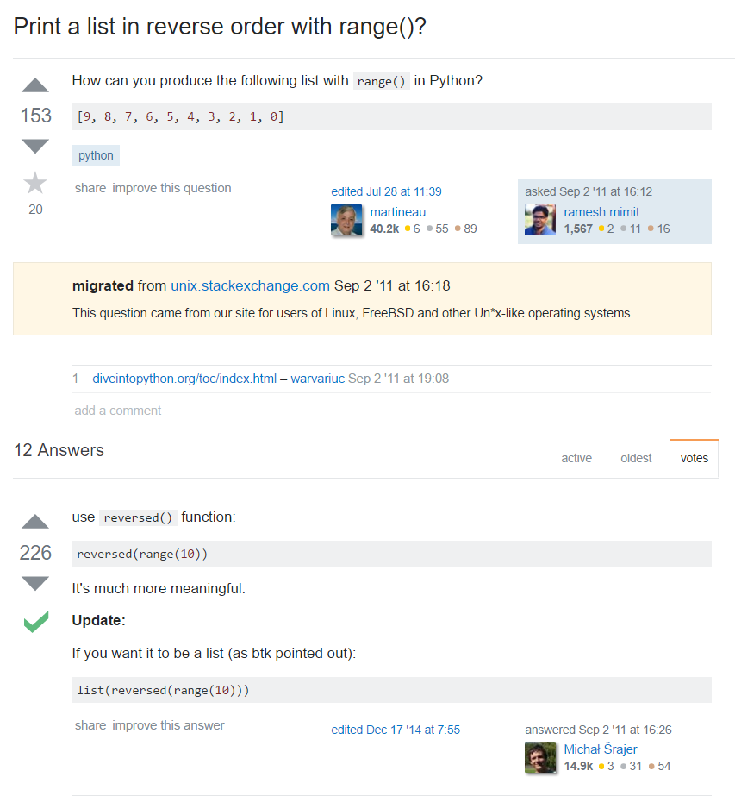

Slide 6
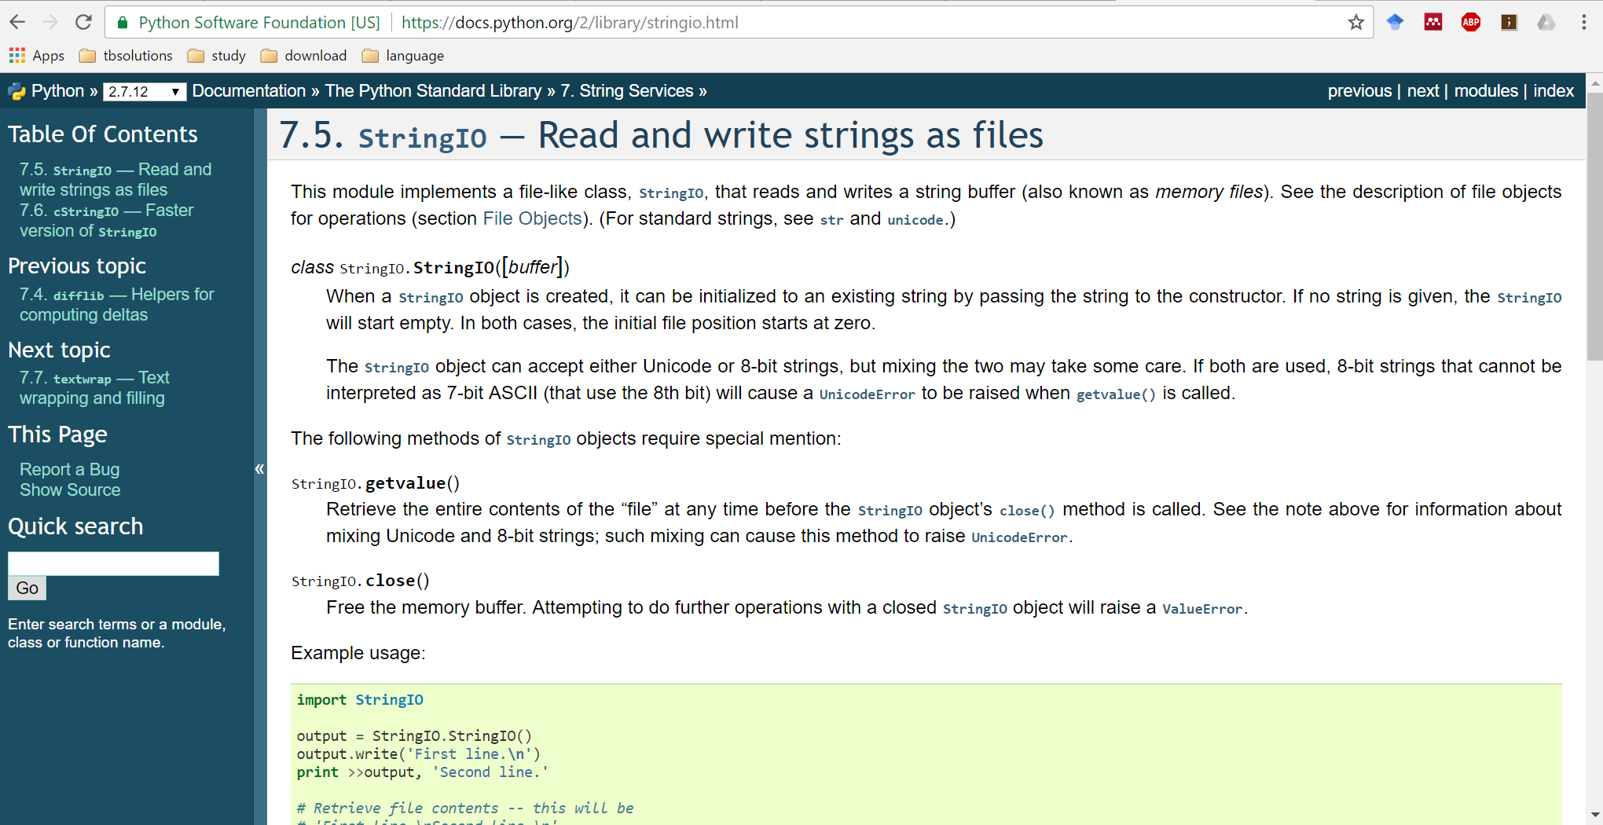

Slide 7
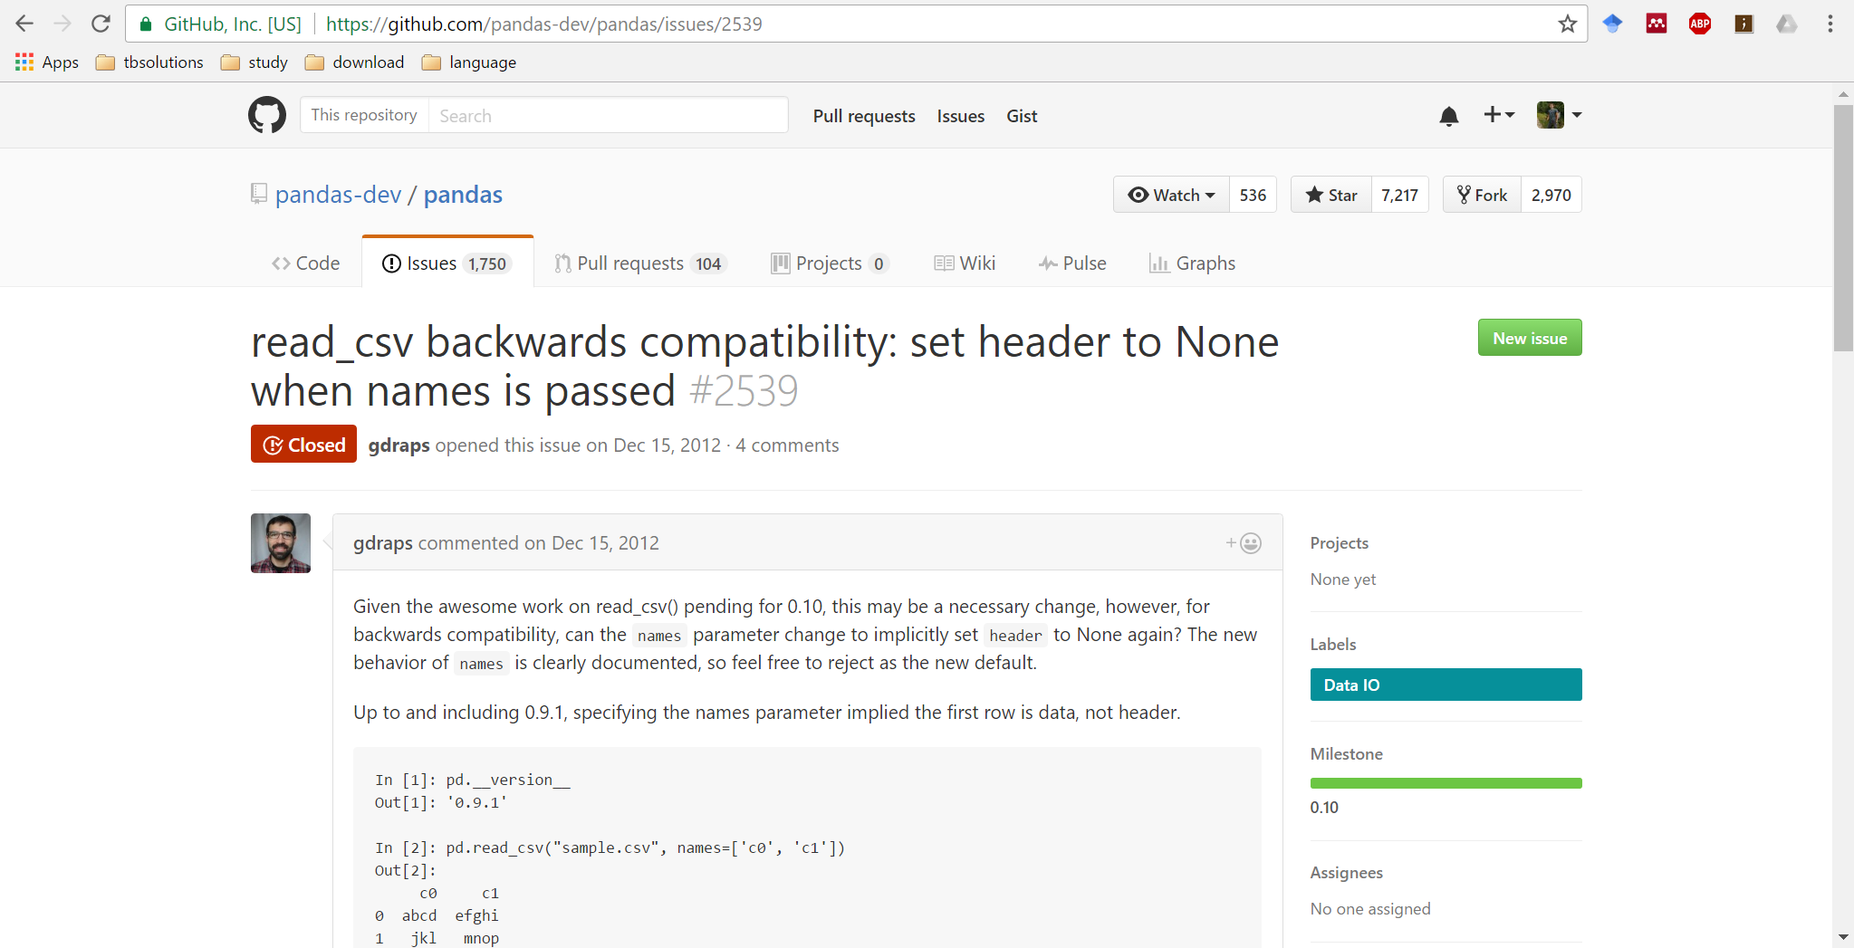

Slide 8
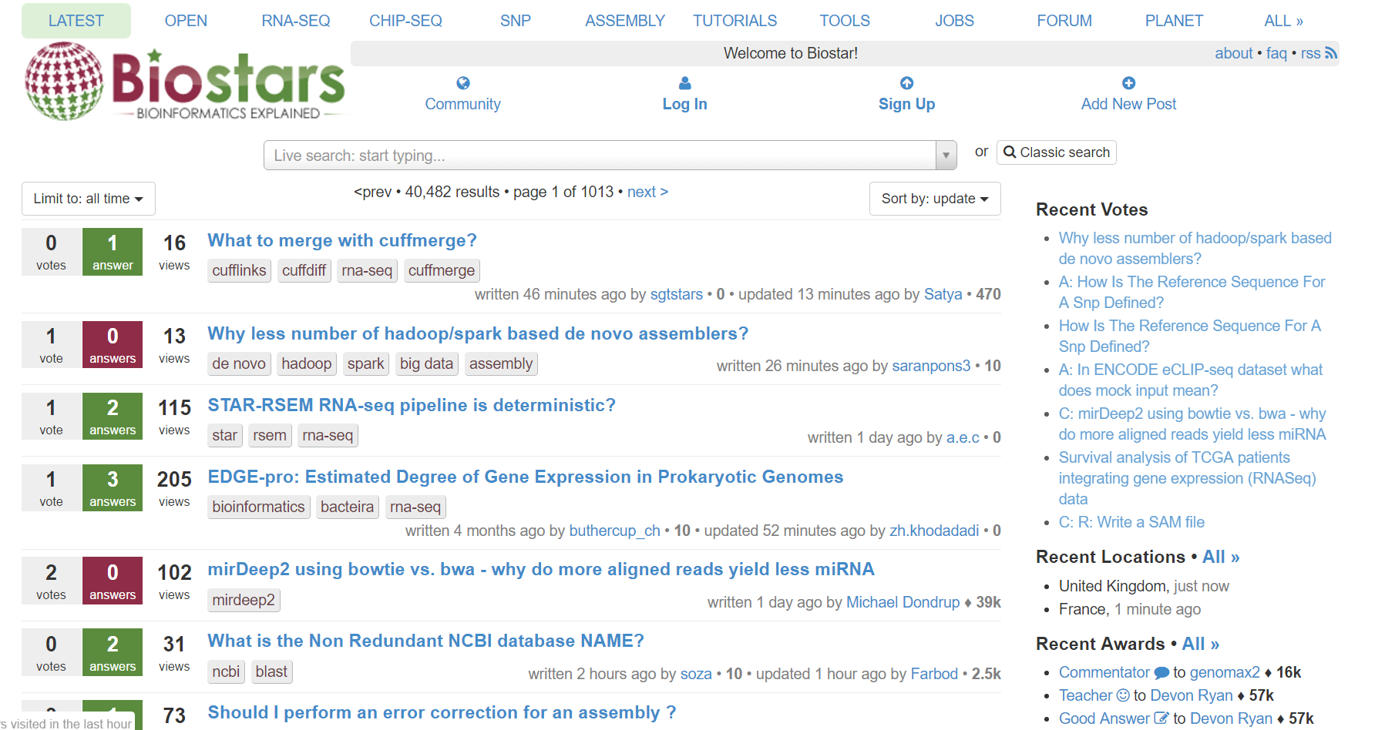

Slide 9
Functions – why?
Code reusability (code duplication is a bad idea)
Code readability (separating logical units, thereby reducing cognitive load)
  Even if a function is only used once

Slide 10
More Python topics
Functions
Modules
Sorting
Working with files

